Slide 1
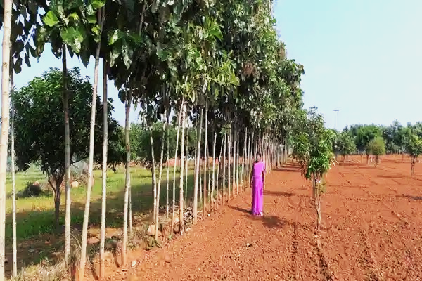

National Rural Employment Guarantee Act (NREGA) Review: Insights and Recommendations

Slide 2
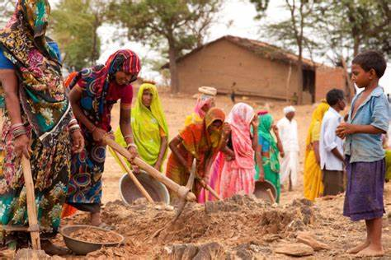
The Goals of NREGA in Rural India
The Mahatma Gandhi NREGA program aims to improve the lives of rural families in India by offering at least 100 days of guaranteed manual labor each year. It prioritizes strengthening the livelihood resources of the most vulnerable, including women, lower castes, and tribal communities. NREGA empowers local communities by involving them in planning and development projects. These projects create lasting infrastructure and resources while also promoting environmental sustainability. The program is committed to transparency and ensures fair treatment of participants through social audits and open information sharing.

Slide 3
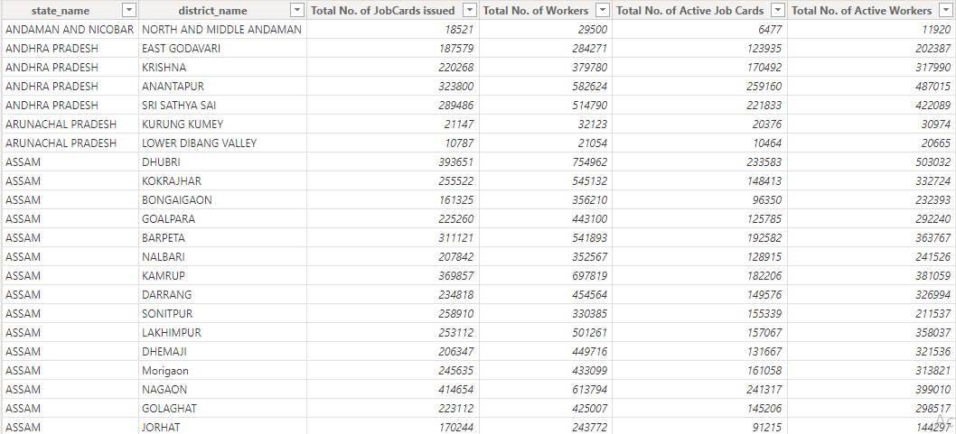
Unveiling NREGA's Impact: A Snapshot of Key Data
Data Source:
Official NREGA MIS data (Government of India), provided by Mentorness
Scope:
Worker Engagement (Job Card Activation Rate, SC/ST Worker Participation), Regional Variations (Job Cards Issued per State, Workers per State), Budget Utilization (State Budget vs. Persondays Generated), Project Completion (Project Completion Rates per State, Ongoing Works per State)

Slide 4
269M Hired Workers
2Bn Persondays Provided
Providing Employment Opportunities in Rural Areas.
Total Days worked by all Workers.
59% Women in the Workforce
36% SC/ST Workers (Combined)
Empowering Women Through Employment.
Supporting Marginalized Communities.
31 Average days of Employment provided per Household
Enhancing Household Income Security.
Overview of NREGA’s Impact

Slide 5
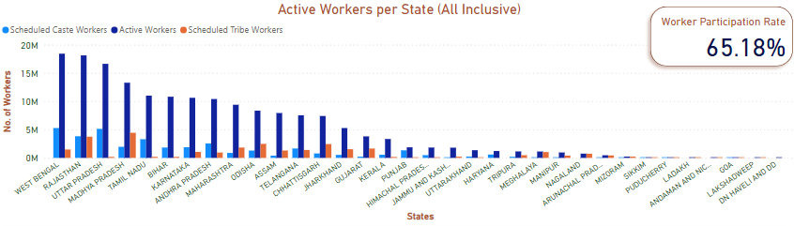
Worker Engagement with NREGA
* Worker Participation Rate = Percentage of Total Workers that are Active

Slide 6
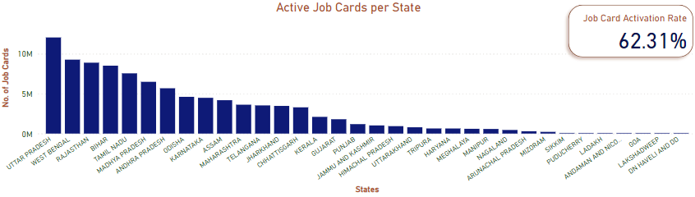
Worker Engagement with NREGA
* Job Card Activation Rate = Percentage of Total Issued Job Cards that are Active

Slide 7
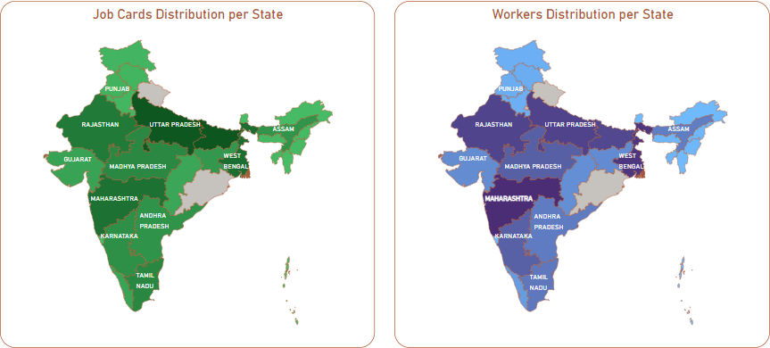
* Lighter colours indicate lower values; darker colours indicate higher values
Regional Disparities in NREGA Implementation

Slide 8
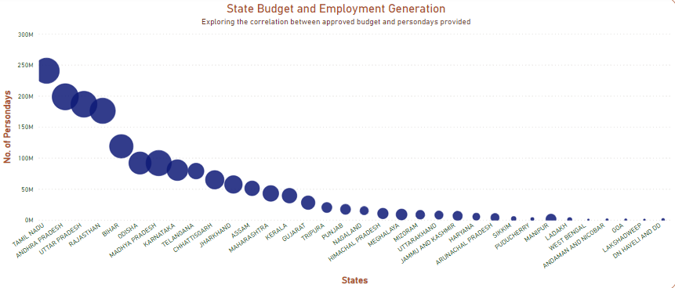
Budget Utilization and Employment Generation
Notes:
As we can see, there is a clear correlation between budgeted Rands allocated per State and the amount of employment it provides. While this not denote causation between the two factors, it is a noteworthy fact that the states with more allocated budget are able to have more people work for more days. Perhaps this is a function of how these funds are spent in the provision of work opportunities.

Slide 9
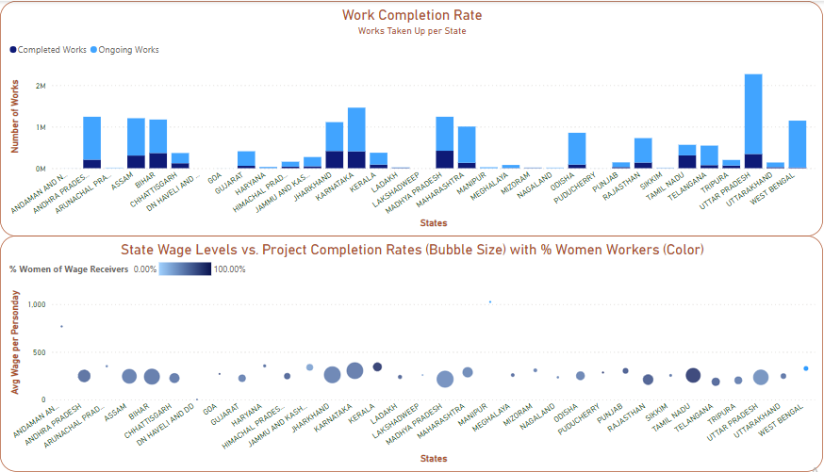
NREGA Project Completion: Factors & Roadblocks

Slide 10
Empowering Rural Development:
Actionable Insights from NREGA Analysis

Slide 11
Key Findings:
Worker Engagement: Worker participation varies significantly across states. Further investigation into outreach programs and project opportunities in high-performing states is recommended.
Budget & Employment: A strong correlation exists between budget allocation and employment generation, highlighting NREGA's effectiveness in utilizing funds for job creation.
Balanced Budget Spending: Analysis suggests efficient budget allocation with resources directed towards essential program components.

Slide 12
Recommendations:
Close the Engagement Gap: Address the identified regional disparity in worker participation by implementing targeted outreach programs in low-performing states. Learn from the successful strategies of high-performing states to maximize impact.
Data-Driven Resource Allocation: Leverage the positive correlation between budget and employment generation to allocate resources strategically based on program data. This ensures funds are directed towards areas with the highest job creation potential.
Knowledge Sharing Network: Establish a platform for states to share best practices in outreach, project management, and resource allocation. This fosters collaboration and continuous program improvement.

Slide 13
Conclusion:
NREGA's positive impact on rural development is undeniable. By focusing on targeted outreach, data-driven resource allocation, and knowledge sharing, NREGA can be further optimized to empower communities and contribute to a more prosperous India.

Slide 14

Thank you!
Presented by Abolarinwa Dabiri
You can reach me on LinkedIn @ www.linkedin.com/in/abolarinwa-dabiri

